Slide 1

An introduction to Anomaly Detection
Ramon van den Akker (Tilburg University)

Slide 2
Goal
Obtain overview:
core ideas
discuss selection of specific methods
Preparation for further self-study

Slide 3
Some applications:
fraud detection
fault detection (including data quality inspection)
predictive maintenance
medical diagnosis
intrusion detection
etc.
Terminology:
`outlier’ instead of `anomaly’
Anomaly detection is the identification of rare items, events or observations which raise suspicions by differing significantly from the majority of the data.

Slide 4
Historical Data available for training
Approach
 | No labels | Some labels | All labels
Supervised learning | X | X | OK
Semi-supervised learning | X | OK | OK
Unsupervised learning | OK | OK | OK
Remark:
often / sometimes (?) it is implicitly imposed that anomaly detection methods are unsupervised
we will only discuss unsupervised methods

Slide 5

Approach
Consider fraud detection with historical dataset for which labels are available
Would you prefer supervised methods or unsupervised methods?

Slide 6
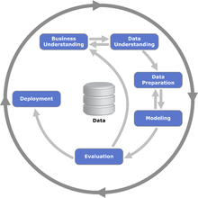
Position in data science workflow

Slide 7

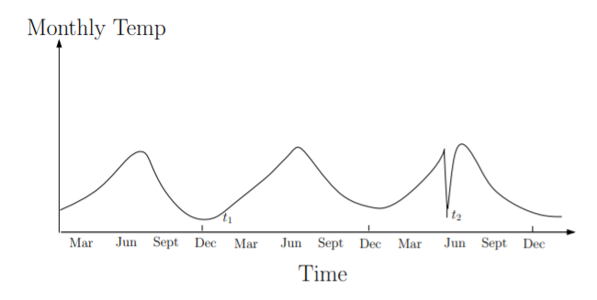
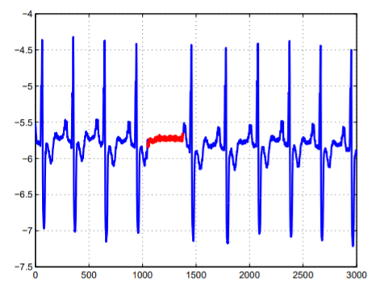
Types of anomalies
Chandola et al. (2009) distinguish different types of anomalies
Point Anomaly
Contextual Anomaly
Collective Anomaly
individual data points can be considered as anomalous with respect to the rest of data
data point is anomalous in a specific context (but not otherwise)
collection of related data instances is anomalous with respect to the entire data set
Chandola, V., A. Banerjee, and V. Kumar (2009). Anomaly Detection : a survey. In: ACM Computing Surveys

Slide 8
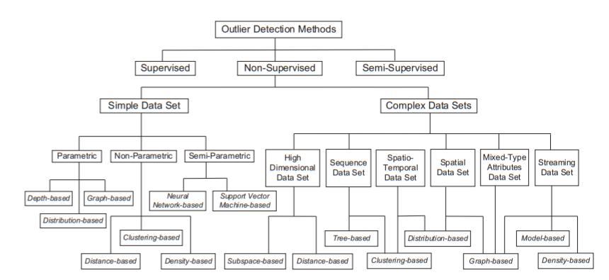
Anomaly Detection methods
Chandola, V., A. Banerjee, and V. Kumar (2009). Anomaly Detection : a survey. In: ACM Computing Surveys
Zhang, Y., N. Meratnia, and P. Havinga (2007). A Taxonomy Framework for Unsupervised Outlier Detection Techniques for Multi-Type Data Sets. Technical report.

Slide 9
Anomaly Detection methods
We discuss selection of methods:
Probability model-based
Cluster and distance-based
Isolation forest
Auto-encoders
Chandola, V., A. Banerjee, and V. Kumar (2009). Anomaly Detection : a survey. In: ACM Computing Surveys

Slide 10
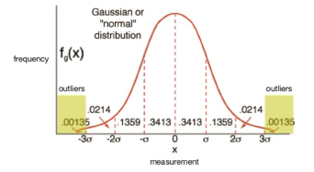
Anomaly Detection A. model-based example
univariate anomaly detection could be implemented by estimating distribution on basis of historical data and computing quantiles of new observations
In low dimensions density can be estimated nonparametrically
But for high-dimensional data parametric models are required, because of `curse of dimensionality’

Slide 11
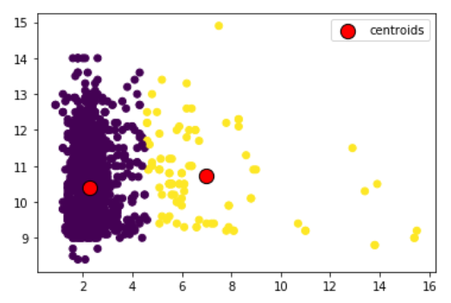
Anomaly Detection B. example using cluster analysis
measure distance to closest centroid
observations with large distance are anomalies
of course, lot of alternative approaches; see, e.g., Mehrotra et al. (2017)
for example, consider small clusters to be anomalies
Mehrotra, K.G., C.K. Mohan, and H. Huang (2017). Anomaly Detection Principles and Algorithms (Terrorism, Security, and Computation). Springer.

Slide 12
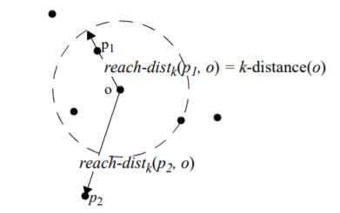
Anomaly Detection B. example using distance-based algorithms
Local Outlier Factor (LOF) algorithm
measures local deviation of a data point to its k nearest neighbors
See Breunig et al. (2000) for details
Breunig, M.M., H. –P. Kriegel, R.T. Ng, J. Sander (2000). LOF: Identifying Density-Based Local Outliers. In: Proc. ACM SIGMOD 2000 Int. Conf. On Management of Data.

Slide 13
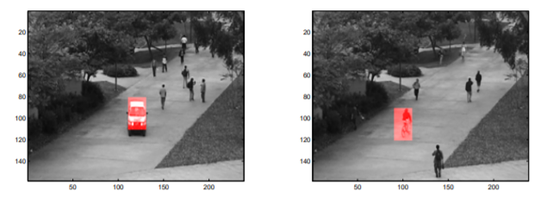
Anomaly Detection B. example using distance-based algorithms
Saligrama, V. and Z. Chen (2012). Video anomaly detection based on local statistical aggregates. In: 2012 IEEE Conference on Computer Vision and Pattern Recognition

Slide 14
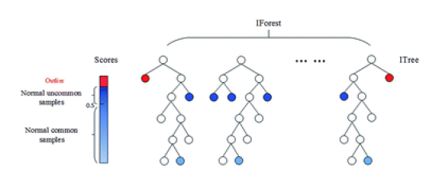
Anomaly Detection C. isolation forest
Liu, F.T., K.M. Ting, and Z.-H. Zhou (2008). Isolation forest. In: Proceedings of the 8th IEEE International Conference on Data Mining (ICDM'08), 413{422. Pisa, Italy
Liu, F.T., K. M. Ting, and Z.-H. Zhou (2012). Isolation-based anomaly detection. ACM Transactions on Knowledge Discovery from Data 6(1)

Slide 15
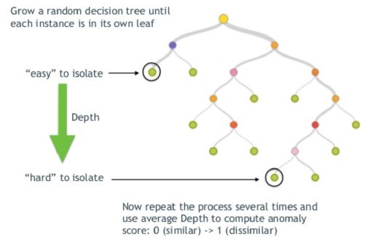
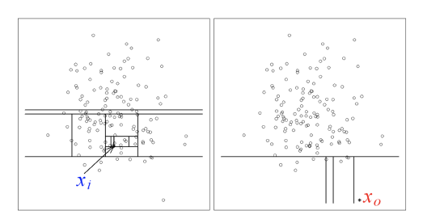
Anomaly Detection C. isolation forest

Slide 16
Anomaly Detection C. isolation forest

Slide 17
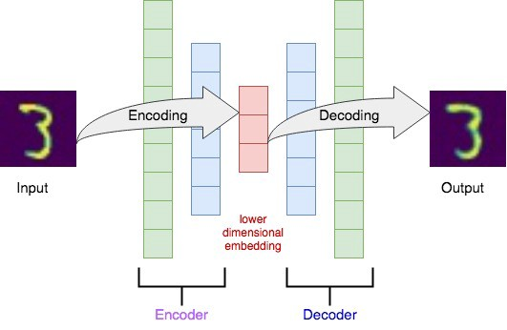
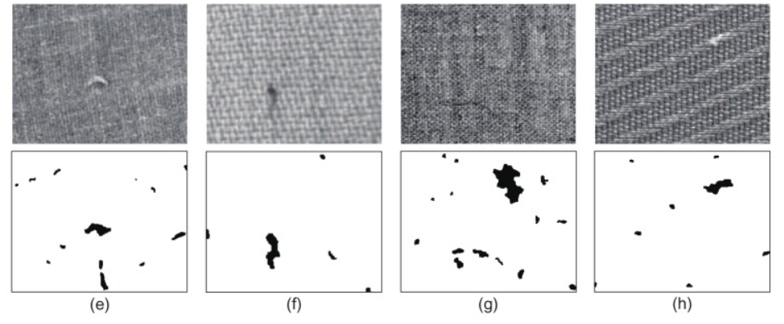
Anomaly Detection D. auto-encoders
Compare input to output → residual
If for given input the residual is too `large’ → anomaly
Mei et al. (2018) used auto-encoder to detect defects in textile fabrics
Mei, S., Y. Wang, and G. Wen (2018). Automatic Fabric Defect Detection with a Multi-Scale Convolutional Denoising Autoencoder Network Model, Sensors (18), pp. 1-18.

Slide 18
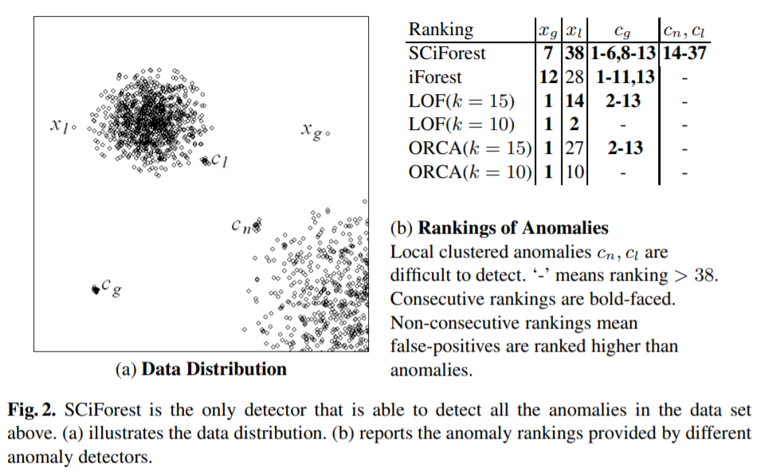
Performance
example
The anomaly clusters consist of 12 datapoints.
Liu, F.T., K.M. Ting, and Z.-H. Zhou (2010). On detecting clustered anomalies using SCiForest. In: Balcázar J.L., Bonchi F., Gionis A., Sebag M. (eds) Machine Learning and Knowledge Discovery in Databases. ECML PKDD 2010. Lecture Notes in Computer Science, vol 6322. Springer, Berlin, Heidelberg.

Slide 19
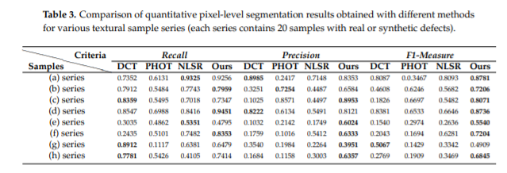
Performance
example
Mei, S., Y. Wang, and G. Wen (2018). Automatic Fabric Defect Detection with a Multi-Scale Convolutional Denoising Autoencoder Network Model, Sensors (18), pp. 1-18.

Slide 20
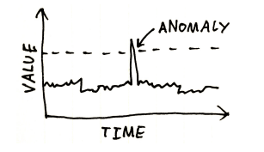
Remarks
dealing with time series
Time series
Time series dimension needs to be taken into account
Classical time series analysis could be/is natural starting point
Also possible to integrate in “standard” algorithms; for example isolation forest?

Slide 21
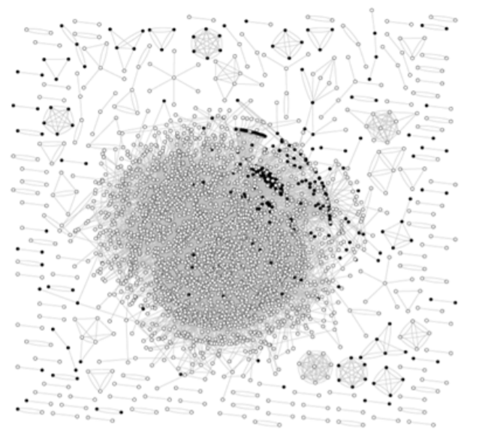
Remarks
dealing with networks
How to deal with anomaly detection in networks?
See Akoglu et al. (2015) for a survey
Akoglu, L., H. Tong, and D. Koutra (2015). Graph based anomaly detection and description: a survey, Journal Data Mining and Knowledge Discovery 29(3), pp. 626-688.

Slide 22

Remarks
dealing with time series of networks
How to deal with time-evolving graphs?
See Akoglu et al. (2015) for a survey
Akoglu, L., H. Tong, and D. Koutra (2015). Graph based anomaly detection and description: a survey, Journal Data Mining and Knowledge Discovery 29(3), pp. 626-688.

Slide 23
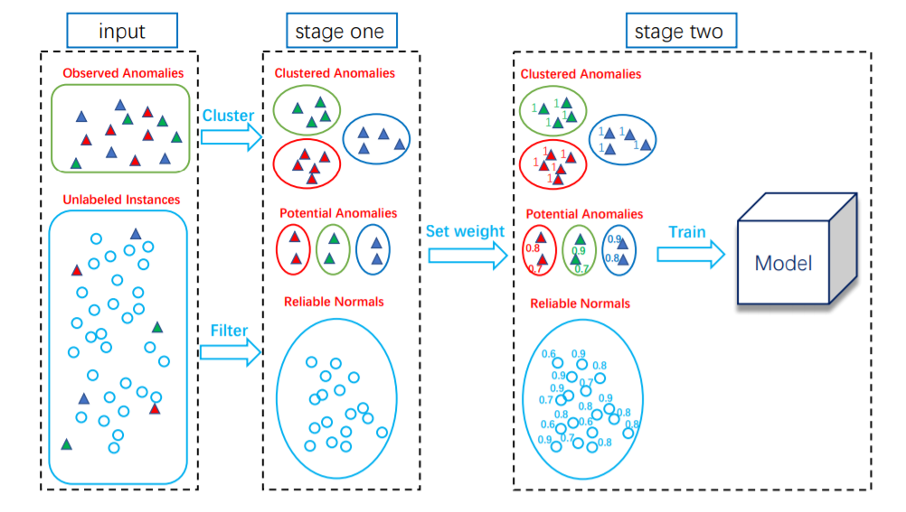
Remarks
example semi-supervised approach
Zhang, J.-L., L. Li, J. Zhou, X. Li, and Z.-H. Zhou (2018). Anomaly Detection with Partially Observed Anomalies. In: Companion Proceedings of the The Web Conference 2018, pp. 639-646.

Slide 24
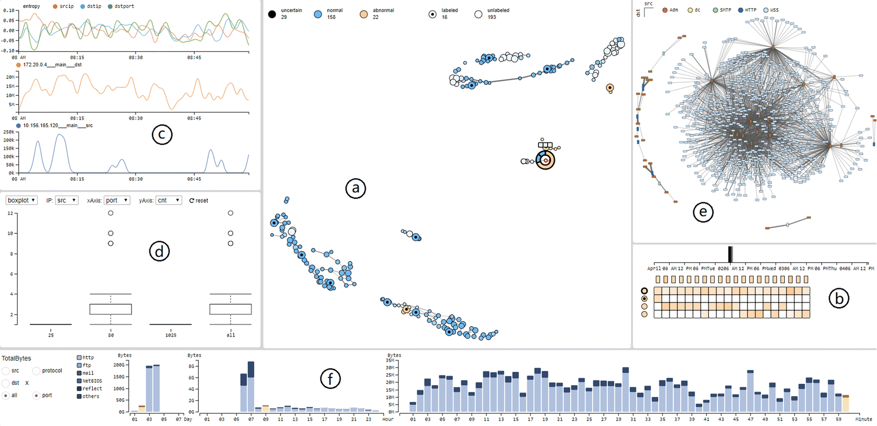
Remarks
visual analytics
Detected anomalies are typically inspected by human. Visual analytics to assist the human-in-the-loop is/can be very relevant. Such dashboard can also be helpful to generate ‘opinion-based’ labels.
Fan, X., C. Li, X. Yuan, X. Dong, and J. Liang (2019). An interactive visual analytics approach for network anomaly detection through smart labeling, Journal of Visualization 22(5), pp. 955–971.

